Slide 1
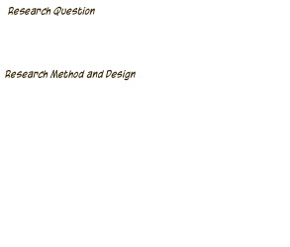
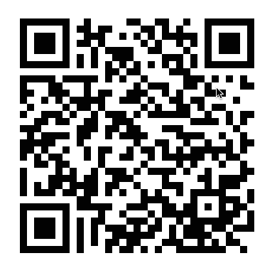
Online Adjunct Higher Education Teachers’ Perceptions of Using
as Instructional Approaches
to Reach Diverse Learners
How do online adjunct higher education faculty members perceive the role of using social media sites as instructional approaches? Open-ended sub-questions will be the following. How do online adjunct higher education instructors perceive social media sites? How do online adjunct higher education instructors perceive social media instructional approaches? How do adjunct higher education instructors perceive the role of social media in the online classroom?
Though the global use of social media increased exponentially in the past decade, online higher education leaders tend to overlook the need for preparing online adjunct higher education instructors to implement the digital change process. According to the change theory in education model, a process must be in place for change to effectively take place. Without undergoing a structured change process, higher education online adjunct instructors may not fully embrace the concept of using social media sites as teaching tools. Therefore, online higher education adjunct instructors may fail to fully implement social media sites, such as blogging, twitter, and Facebook, as teaching tools in the classroom, and the use of social media site challenges may outweigh digital opportunities to increase student learning outcomes through real world applications. Online adjunct higher education faculty members’ perceptions on the role of using social media sites as instructional approaches in the online classroom will be explored in this qualitative study. The purpose of this qualitative exploratory case study will be to examine how online adjunct higher education faculty members perceive the role of using social media sites as instructional approaches in the online classroom. The sampling method will be purposive sampling, and 15 online adjunct higher education instructors will be selected to participate in the purposed study. Online higher education leaders may use this study to create and institute a digital change process that will be instrumental in creating a positive change for adjunct online faculty members.
The design for this study will be an exploratory case study in which the participants will be online adjunct instructors who teach at an online higher education institution. In this study, a range of participants’ perceptions on the role of using social media sites as online instructional approaches will be investigated.
The sampling method will be purposive sampling, and 15 online adjunct higher education instructors will be selected to participate in the purposed study. At the time of the interviews, the participants in this study must be employed as an adjunct online higher education instructor, and they must have worked as online adjunct higher education instructors for at least two years. The participants will be online adjunct higher education instructors from on online institute of higher learning in North Central Ohio.
The participants that sign an Informed Consent form will be interviewed via Skype, and the Skype sessions will be not be over one hour. A third and a fourth interview may be requested if saturation is not met by the end of the first or second interview. If needed, the interviews will last no longer than an hour. Data will be triangulated through interviews, observations, and artifacts such as reflections, lesson plans, or online social media site activities. During each interview, participants’ body language and nuances will be noted and compared. After data are collected, NVIVO10 qualitative software will used to identify themes and patterns. Data will be coded, and only the researchers will know the codes.
The purpose of this qualitative exploratory case study will be to explore how online adjunct higher education faculty member perceive the role of using social media sites as instructional approaches in the online classroom. The participants will be a purposive sampling of online adjunct instructors who are part time faculty members. The participants will have been online adjunct instructors for at least two years. The qualitative method will be the most appropriate for the purpose of this study. An exploratory, descriptive approach is appropriate when little is known about a topic. Online adjunct higher education instructors’ perceptions as derived from lived experiences of social media sites based instructional approaches will be explored in the proposed research. A case study will be used to examine the external events related to the phenomena of using social media as instructional approaches in online classrooms. The participants will be online adjunct higher education instructors from an on online institute of higher learning in North Central Ohio. Digital gaps are challenges that online adjunct instructors identify as issues in using social media to teach in the online classroom. Online faculty members may express that digital gaps and issues of a lack of knowledge about how to use social media in the classroom and the lack of motivation to learn how to use social media to expand online teaching.
Currently, the numbers of Generation Z students who will enter institutes of higher learning have increased globally. To make sure that the learning styles of these students are met, a change policy must be in place to accommodate the digital preferences of these learners. There is a gap in the literature on the use of social media in online classroom. The role of social media as instructional approaches in online classes will be examined in this study. Future researchers may use the findings in this study to identify others social media instructional issues.
Based on your experiences, how do you perceive your role as an online adjunct higher education faculty member in the online classroom?
How do you perceive the role of using social media sites in the higher education online classroom?
How do you view the use of blogging as an instructional approach in the online classroom?
Based on your experiences as an online adjunct faculty member, how do you view the use of blogging as an instructional approach in your online classroom?
How do you view the use of twitter as an instructional approach in the online classroom?
Based on your experiences as an online adjunct faculty member, how do you view the use of twitter as an instructional approach in your online classroom?
How do you view the use of Facebook as an instructional approach in the online classroom?
Based on your experiences as an online adjunct faculty member, how do you view the use of Facebook as an instructional approach in your online classroom?
Recommendations for faculty training in the use of social media as an instructional approach
Best practices for developing classroom community
Teaching strategies for information literacy through social media
Instructional approaches for reaching diverse learners
Barbara Fedock, Ed.D
Melissa McCartney, Ed.D
John Avella, Ph.D
Doug Neeley, Ph.D

